Slide 1
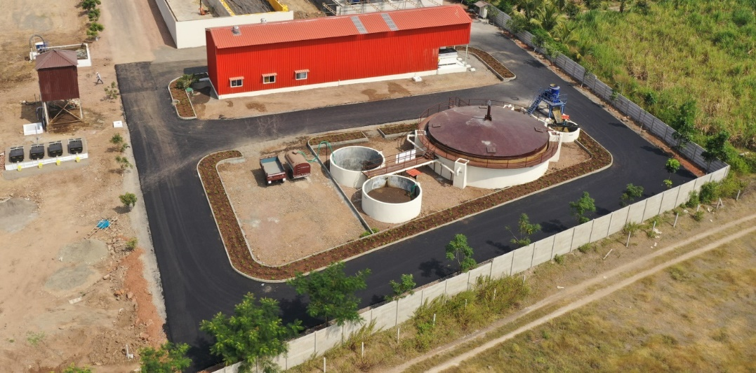

APPLYING SCIENTIFIC WASTE MANAGEMENT TECHNOLOGY
FOR
CATTLE DUNG
Urja Bio System Pvt. Ltd.
302, Amelia, Rege Path, Lakaki Road,
Model Colony, Shivajinagar, Pune -411016
Phone - +917774043040
www.urjabiosystems.com

Slide 2


URJA BIO SYSTEM PVT. L TD.
More than 250 installations of biogas to
power generation projects across India.
16 Years extensive experience in waste treatment sector.
More than 10,000 installation of family size plants in Maharashtra.
15 Projects for Community based biogas for
Villages, 5 CBG projects.

Slide 3








CONT….
Urja is providing its service for complete waste management for different sectors from 2006.
Urja has dedicated team of young and enthusiastic engineers comprising chemical, civil, mechanical, electrical, streams...
This has given a strong base to provide suitable customized designs as per situation demand and clients requirements.
Urja focuses on providing complete sustainable scientific waste solutions to clients.
Our valuable client’s feedback also provides is opportunity to improve ourselves day by day.

Slide 4
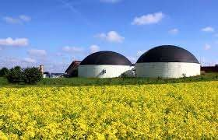
BIOGAS CONCEPT
The Term Biogas refer to the mixture of gases primarily containing CH4 (Methane), CO2 (Carbon dioxide) trace of H2S originated from anaerobic ( in absence of oxygen ) degradation of organic material.
Wet waste will be treated in the Bio gas plant to generate Bio methane.
The Bio-methane is a very reliable fuel for cooking food or can also be converted in to Electricity for street lights or for pumping the water.
Bio gas plant also gives one more important bi product i.e. high quality
organic fertilizer, which can be used in the Garden of the urban areas.

Slide 5

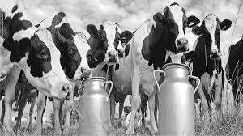
DAIRY SECTOR IN INDIA
Dairy Industry in India had a long historical tradition.
World 2nd largest milk producer.
India produces 17% of the World’s total dairy production.
75% of rural households own an average, two to four animals.
Dairy provides a source of regular income.

Slide 6

LIVESTOCK WEALTH OF INDIA
The livestock sector is the backbone of India’s economy in terms of
Income
Employment
Equity
Sustainability
Foreign
Exchange
Earnings
India occupies premier portion in its livestock wealth with 215 million
cattle, 98 million buffaloes, 61 million sheep and 124 million goats.

Slide 7


It plays an important role in national economy, social economic and rural economy as supplementing family incomes and generating gainful employment in the rural sector.
Livestock population in India makes up about 12% of the world livestock
population.
One cattle produces 9 -15 kg cow dung and 2-4 litre of urine-not properly used due to lack of knowledge .
Livestock an importance source of manure for crop production and fuel for domestic use. It is a source of minimizing use of non renewable energy.

Slide 8
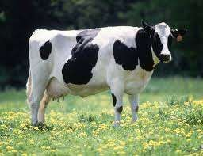
CONT…..
Urja team believes dung is the main product as it is available 365 days and we prove this from our projects.
1 cow gives 15 kg dung…15 Kg X 365 days = 5250 Kg per Annum
Equivalent to say 300 units power or 100 kg LPG
Also gives 10,000 liter value added organic manure annually.
Bio power can be use for pumping the water or to run any machinery as per availability.

Slide 9
URJA’S ACTION PLAN FOR WASTE MANAGEMENT
WASTE AUDIT
Identify bulk waste generators
Understand waste generation pattern
Understand utilization application
DPR for subsidy / CFA claim
Engineer, Procure & Commission Waste Management optimized to site
ENERGY MANAGEMENT
Comprehensive O&M Services
Long Term Service Agreements
Assistance in Bio – CNG Sales
Assistance in Bio – Fertilizer
Formulation as per crop & sales

Slide 10
HOW BIOGAS PLANT WORKS ?
Effluent … Ammonium N Phosphorus Potassium
Influent … Organic N Ammonium N Phosphorus Potassium
Digester
Slurry
Settled solids
Anaerobic digesters do not significantly reduce manure nutrient content.
Solids accumulated in the bottom of the digester also contain some P & N
Ammonium N increases as Organic N is transformed in the anaerobic process.
Nutrients are not reduced through the anaerobic process

Slide 11
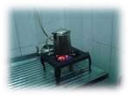
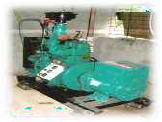
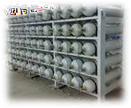
OPTIONS FOR BIOGAS UTILIZATION
Heat / cooking Application
Biogas
Storage
Biogas Up gradation
Electricity
Generation
Biogas.
...
CH4
CO2
Trace
gases
Biogas CNG For Cylinder Filling
Biogas Digester

Slide 12
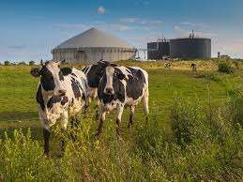
LIST OF SUCCESSFUL INSTALLATION OF BIOGAS PROJECT BASED ON CATTLE DUNG
Sundar Dairy Vidisha, M.P. (Shri. Shivraj Singh Chouhan Saheb C. M. M.P)
Govind Baug Baramati, District Pune (Hon’ble Sree SharadPawar saheb).
Sarda Dairy Farm – Nashik (1200 HF farm, running on biogas since last 4
years).
Modern Dairy Farm – Nashik, (250 HF cattle farm).
J K Farms, Kollam – Kerala- 50 KW
Olitia Foods – jaipur, Rajasthan- 24 KW
Navsagar Dairy, Dhanera, Gujarat- 50 KW
Arco Steel – Kheda, Anand – Gujarat- 50KW
DS Group (Rajnigandha Pan Masala wale), Gurgaon. – 100 KW
NDDB, Alamadhi, Tamilnanu.- 24KW
Buffalo Research Center, Hisar, Haryana.- 50 KW

Slide 13
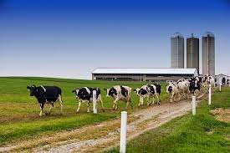

CONTI…….
Sarda Dairy Farm, Raipur, CG. (2500 HF farm, 1000 cum biogas plant).
Nutri India Food & Dairy Farm – Gurgaon/Haryana.
Haveli Dairy Farm- Telangana (1000 HF cattle farm on biogas to power since last 5 years).
Kapila Dairy Farm – Telangana (1000 HF cattle farm on biogas to power
since last 5 years).
Bull Mother Farm, Bhopal, M.P Govt. project – 200 cum with 24 kW power
generations.
BAIF, Urali Kanchan- 12KW
SRC Farm, Kolkata – 50 KW
Happy Milk, Bangalore- 150 KW
Bhagyalaxmi Farm, Pune - 50 TPD dung , 250 KW
Nutri Milk, Indore- 50KW
Royal Dairy, Chennai -TN. 24 KW .
SS Dairy, Kota. Raj. 24 KW .

Slide 14
CASE STUDY OF SARDA DAIRY, RAIPUR, CG
Sr. No. | Particulars | Output
1. | No. of cattle | 1500 nos.
2. | Availability of cattle dung | 30,000 Kg/day
3. | Biogas generation | 1200 cum/day
4. | Power generation | 150 Kw/day
5. | Liquid organic manure | 50,000 lit/day
6. | Solid organic manure | 9000 Kg/day
7. | PROM generation | 6000 Kg/day

Slide 15


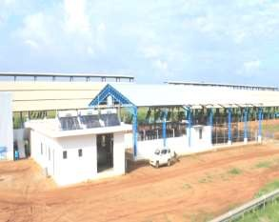
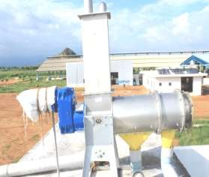

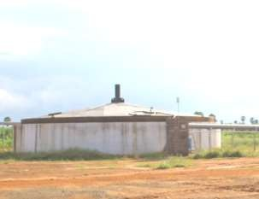
PROJECT OVERVIEW
CATTLE SHED
SLURRY
SEPARATOR
DIGESTER

Slide 16


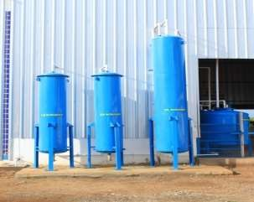
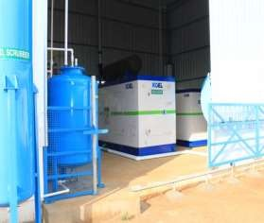

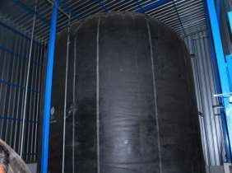
PROJECT OVERVIEW
SCRUBBING TANK
ENGINE ROOM
BALLOON ROOM

Slide 17

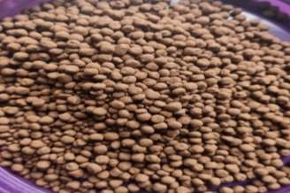
MANURE PROCESSING FOR BETTER VALUE ADDITION TO PROM
Instant slurry will filtered to separate solids and Liquid
Solids will be dried and mixed with rock phosphate to produce Phosphate Rich organic manure (PROM)
Further value addition as per requirement can be done to fetch better revenue.

Slide 18
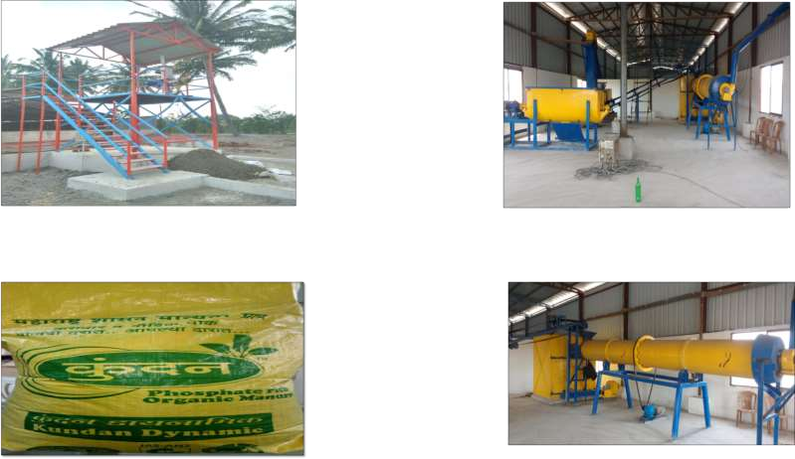
PROCESSING OF MANURE INTO PROM
Slurry Separator
Mixing and blending machines
Actual PROM bag produced at our unit
Granulator

Slide 19


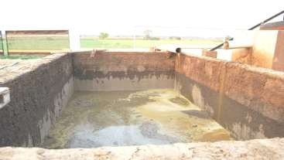
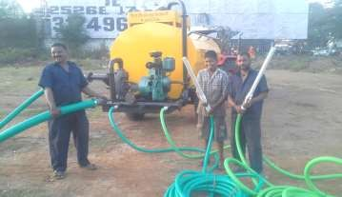

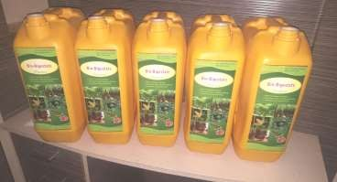
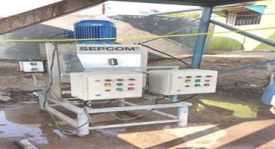
LIQUID FORM OF MANURE FOR MICROFILTRATION & PACKING
Digested Slurry
Micro filter

Slide 20


OVERSEAS PROJECTS
7.5 TPD dung waste biogas to power generation plant at Lusaca,
Zambia.
5 TPD fruit processing waste to power generation plant at Elvenagri
ltd., Dar-E-Salaam, Tanzania.
2.5 TPD dung waste to power generation plant at Gambia

Slide 21

SOCIAL BENEFITS
Job creation for local people
Health improvement - smell reduction, pathogen reduction, dieses reduction due to utilization of clean energy & end products use as land fertilizer instead of chemical fertilizer.
Lifestyle improvements

Slide 22

ENVIRONMENTAL BENEFITS
Protect forest
Avoid GHG emissions (CO2, CH4 reduction)
Clean environment

